Slide 1
Software Project Management II [23] Managing Public Sector Projects
Sanjay Prabhu Kunjibettu

Slide 2

Learning Objectives
Public Sector Definition and Characteristics
Importance of managing public sector projects
Competencies of Project Managers
Project Management Techniques
State-of-the-art – Hybrid methodology
Characteristics
Current Limitations
Future Proposal – Agile methodology
Public IT Sector
Advantages
Current Limitations
Influence on Project Management
I LOVE
AGILE
Notes:
1.

Slide 3

1. Public Sector Definition and Characteristics
PMI (2018) definition of Projects
Public Sector Projects
Size (>=500 employees)
Influences - Regulations, Bureaucracy, Politics, Private firms
Project Initiation Management
Public sector project owners
Stakeholders
Project Managers
Internal and external teams
Institutional complexities
Internal vs external conflicts
Delays
National and Geopolitics
Notes:
According to PMI (Project Management Institute) (2018), projects are defined as efforts or undertakings committed to deliver goods and/or services, often involving clients, stakeholders, users, customers, project managers and many other participants.
Public sector projects are characterized as large undertakings employing more than 500 peoples, often called as public workers.
They are greatly influenced by regulations, bureaucracy, politics, and sometimes private firms.
Project Initiation Management – foundations of a new project are laid by the public sector project owners, stakeholders, project managers and the teams which can be internal or external.
Institutional Complexities – refers to the intricate nature and environment of the public sector project often influenced by the internal vs external conflicts, delays and national and geopolitical issues.

Slide 4

2. Importance of Public Sector Projects
National Employment
Backbone of National Economy
Impact on Global Economy ?
OECD Countries
Developing Countries
Others
Community Welfare
Infrastructural improvements
https://www.bmi.bund.de/EN/topics/civil-protection/critical-infrastructure-protection/critical-infrastructure-protection-node.html
Examples of technological advances in public sectors
Ex: Deutsche-Bahn (Germany) – efficient and easy train booking system
Ex: Unified Payments Interface System (India) – consolidating all payment types, systems and modes using simple one timer QR codes
Notes:
Public sector projects hold significant potential for national and global development, providing employment opportunities and promoting community welfare through infrastructure improvements, technological advances and many more.
OECD: Organisation for Economic Co-operation and Development
Public sector projects greatly boost the national and global economies as they not only fulfil the needs of community welfare and national employment, but also impact directly or indirectly the international trade routes.
These developments have different results in different countries and economies – OECD vs developing countries vs others (under developed countries).

Slide 5
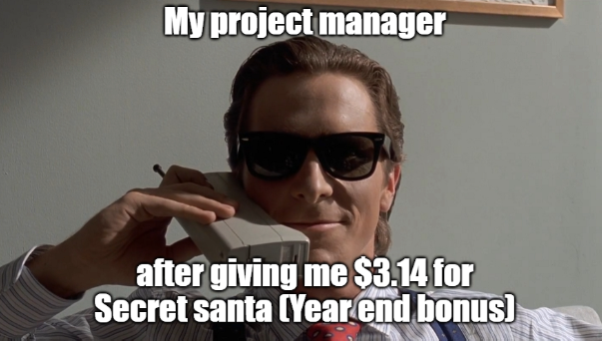
3. Competencies of Project Managers
Importance of Project Managers in project management
Influence of project managers to the success of public sector projects
Why do some project managers fail to deliver irrespective of the methodology?
Abandonment of stakeholder and risk management
Stringent regulations and bureaucracy
Ideal competencies
Communication Management
Experience
Domain Knowledge
Notes:
Project Managers, also referred to as team leaders[2], are usually appointed after the public sector project business case has been approved[8] by the public owners, who are the heads of the public sector organizations delivering and implementing the public sector project
It is necessary for project managers to align themselves along with the organizational goals, functions and structure of the project in order to manage the objectives. Strong technical, interpersonal and soft skills are also required to coordinate activities and communication between the stakeholders, project owners and team members.
Project managers contribute greatly to the success of project management:
Effective Planning and Scheduling
Stakeholder Engagement and communication management
Resource Management and Budget Planning
Compliance and Regulatory Adherence
Leadership and Team Management
Failure to deliver:
Abandonment of stakeholder and risk mgmt – due to various reasons ( communication management issues, skills or technologically backward)
Regulations and bureaucracy – Strict rules often create difficult working conditions for project managers to fully utilize their skills freely.

Slide 6

4. State of the art - Hybrid Methodology
Definition and Characteristics
Multi party project alliance framework
Advantages
Able to meet the demands of both
the external and the internal teams
-> quick resolution of institutional complexities
Disadvantages
Vulnerabilities of public owners and public entities
External demands tend to be prioritized -> Internal Chaos
Inefficiencies in Stakeholder management
Case Study: Lakeside Tunnel Project (European)
* Matinheikki, Juri & Aaltonen, Kirsi & Walker, Derek. (2018). Politics, public servants, and profits: Institutional complexity and temporary hybridization in a public infrastructure alliance project. International Journal of Project Management. 37. 10.1016/j.ijproman.2018.07.004.
Notes:
The hybrid form of project management is the state of the art project management system followed worldwide to achieve project success in the public sector.
This is a type of project management technique that combines several strategies to manage large scale public sector projects in order to avoid failure in dealing with institutional complexities.
Selective Coupling - Hybrid frameworks address institutional complexity and conflicting demands by organizing temporary smaller organizations that aim to satisfy as many needs and requirements as possible without creating tensions between the different actors involved.

Slide 7
… More on Lakeside Tunnel Project
Public sector project, 2012-2016, € 180 million
Public owners – City Planning Department, NTA (National Transportation Authority)
Private providers (3) – infrastructure, engineering and construction sectors
Challenges
The refusal of the National Association of Civil Engineers to admit anyone without a Master’s degree or equivalent in civil engineering during the selection procedures.
the non-profit motives of the NTA clashing with the private sector providers
the internal political debate prolonging the funding by the city and more

Slide 8
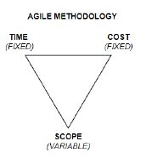
4. Proposal - Agile Methodology
Definition and Characteristics
Inversion of the traditional magic triangle
Advantages
Incremental in nature
Efficient Stakeholder, Communication, Risk,
Scope management
Challenges
Regulations and bureaucracies limit the flexibility and the incremental nature
Limited success stories -> tilting more towards IT sectors
Case Study: Portuguese Public IT sector
Ribeiro, Afonso & Domingues, Luisa. (2018). Acceptance of an agile methodology in the public sector. Procedia Computer Science. 138. 621-629. 10.1016/j.procs.2018.10.083.
Notes:
Agile methodology emerged as an alternative to the traditional approaches in IT sector to address the excessive bureaucracy and inefficient regulations and frameworks.
Agile focuses more on creativity, control, relationship building with the customers, feedback, responsibility, accountability and prioritizes end results over complex documentation.
Scope management - is the process of defining, and managing the scope of a project to ensure that it stays on track, within budget, and meets the expectations of stakeholders.

Slide 9

… More on Portuguese Public IT sector company
Initial challenges with traditional project management methods
Proposal to adopt agile -> scrum framework
Success story
Surveyed more than 90% of the project managers across all departments in the company
>= 50% of the survey (average) voted YES for agile adoption
Limitations of this research
Tilting towards IT Sector
Tilting towards developed economies
Generalized adoption for Agile ?
Notes:
The company had two project areas - internal and external. The internal projects were easily managed by an internal project manager leading an internal team using the company’s internal resources and facilities. However, the external projects suffered from communication problems as the internal teams were not able to communicate smoothly with the external teams who were often given the majority share of the responsibility of developing the products. This also lengthened the deliverables causing delays and stoppages. It was then decided to choose a methodology that was flexible and incremental in nature, where they could easily keep track of tasks for the external teams, note their deadlines and also communicate effectively. They adopted a Scrum framework of the Agile methodology to meet the overall requirements.

Slide 10
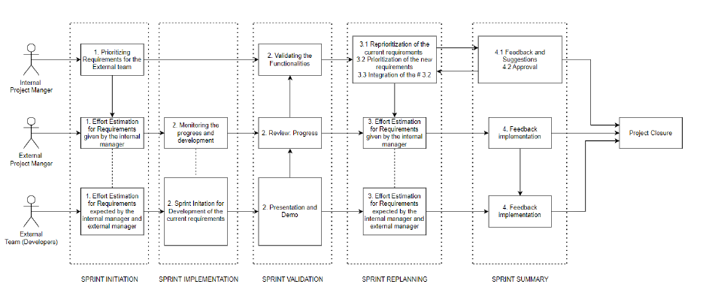
… Agile Scrum framework

Slide 11
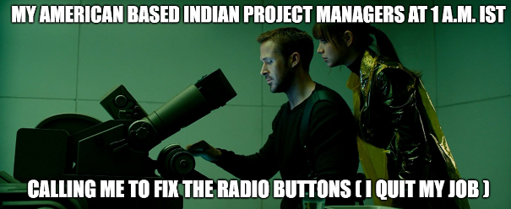
Wrap-Up and Conclusions
Influence on project management
Communication management
Stakeholder management
Time, Cost and Scope management
Project planning management
Agile Scrum model
Project Managers
Influence on project management success
Future Scope of this research
Explore more success stories from developing economies
No need to worry about generalizing results taken from the developed and the OECD countries
More scientific data -> strengthens the proposal for agile
Different economies follow have different regulations -> how can agile overcome them regionally ?

Slide 12
References
[1] de Lemos Dias, Taciana & Oliveira, Bruno & Carneiro, Teresa Cristina & Moura, Ralf & Lima, Susileia. (2023). Project manager competencies associated with the projects’ success in the public sector.. Revista deGest˜ao e Projetos. 14. 1. 10.5585/gep.v14i2.23651.
[2] Bogdanova, Margarita & Parashkevova, Evelina & Stoyanova, Mariela.(2020). AGILE PROJECT MANAGEMENT IN PUBLIC SECTOR– METHODOLOGICAL ASPECTS. JOURNAL OF EUROPEANECONOMY. 19. 283-298. 10.35774/jee2020.02.283.
[3] Ribeiro, Afonso & Domingues, Luisa. (2018). Acceptance of an agile methodology in the public sector. Procedia Computer Science. 138. 621-629. 10.1016/j.procs.2018.10.083.
[4] Rowe, Kevan & Whitty, Jonathan & van der Hoorn, Bronte. (2024).Creating authority and autonomy: Necessary dialectical tensions in public sector project management. Project Leadership and Society. 5.100119. 10.1016/j.plas.2024.100119.
[5] Khan, Asadullah & Waris, Muhammad & Panigrahi, Shrikant & Mirza,& Sajid, Rizwan & Rana, Faisal. (2021). Improving the Performance of Public Sector Infrastructure Projects: Role of Project Governance and Stakeholder Management. Journal of Management in Engineering. 37.10.1061/(ASCE)ME.1943-5479.0000886.
[6] Waris, M. & Khan, Asadullah & Abideen, Ahmed & Sorooshian, Shahryar & Ullah, Mehfooz. (2022). Stakeholder Management in Public Secto Infrastructure Projects. Journal of Engineering Project and Production Management. 12. 188-201. 10.32738/JEPPM-2022-0017.

Slide 13
…References
[7] Nekvapilov´a, Ivana & Pitas, Jaromir. (2017). The Manager Competences for Risk Management in the Public Sector. International conference KNOWLEDGE-BASED ORGANIZATION. 23. 10.1515/kbo-2017-0065.
[8] Nekvapilov´a, Ivana & Pitas, Jaromir. (2016). Factors Affecting Project Management in the Public Sector. International conference KNOWLEDGE-BASED ORGANIZATION. 22. 10.1515/kbo-2016-0037.
[9] Brunet, Maude. (2018). Governance-as-practice for major public infrastructureprojects: A case of multilevel project governing. International Journal of Project Management. 37. 10.1016/j.ijproman.2018.02.007.
[10] Matinheikki, Juri & Aaltonen, Kirsi & Walker, Derek. (2018). Politics,public servants, and profits: Institutional complexity and temporary hybridization in a public infrastructure alliance project. International Journal of Project Management. 37. 10.1016/j.ijproman.2018.07.004.
[11] Maria Dietel and Moreen Heine. 2020. Agility in public sector IT projects. In Proceedings of the 13th International Conference on Theory and Practice of Electronic Governance (ICEGOV ’20). Association for Computing Machinery, New York, NY, USA, 803–806.https://doi.org/10.1145/3428502.3428625
[12] Schmidt, Werner & M¨uller, Andrea. (2024). Differing industrial relations:The public and the private sector in Germany. Industrial Relations Journal. 10.1111/irj.12429.

Slide 14

[Further] Questions?!

